Slide 1

Bonitron Inc.
If You Have VFDs You’ll Need Some Of These…
Dedicated To Engineering Quality Industrial Electronics Since 1962!
1
Notes:
Nashville TN

Slide 2

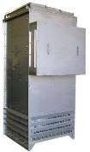
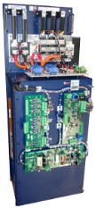
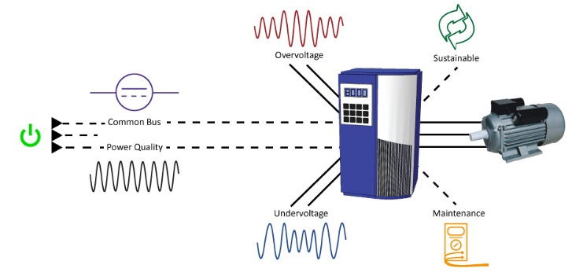
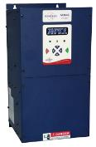
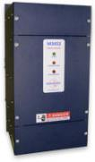
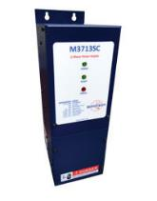

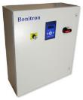
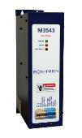

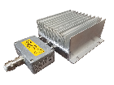
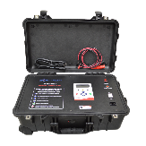
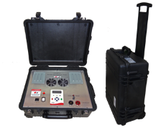
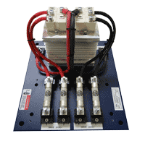
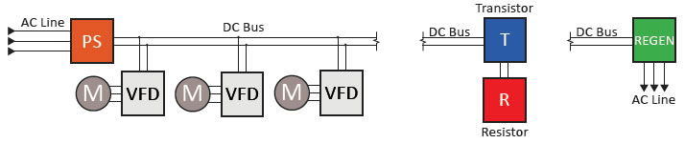
Introduction to Bonitron
Line Regeneration, Braking Transistors & Resistors, Single & 3 Phase DC power Supplies, Sag & Full Outage Backup for VFDs
Bonitron designs and manufactures industrial power electronic modules. We specialize in power electronic assemblies for manufacturers of Variable Frequency Drives and system integrators that support critical applications within many industries worldwide. Bonitron Variable Frequency Drive (VFD) Option Modules include Line Regeneration Modules, Dynamic Braking Transistors and Resistors, Power Loss Ride Thru Modules. These products allow variable frequency drive systems to operate effectively and avert faults and production system shut downs that are due to poor power quality or system dynamics. Bonitron equipment is sold and supported by the distribution and integration channels of major drives manufacturers.
Diode Modules, Capacitor Maintenance Products

Slide 3
Introduction
Nashville, TN
USA
Manufacturer of VFD Accessories and Drive Engineered Solutions
All Products Designed by
Bonitron Inc. Engineering
First VFD Solutions Designed for The Fibers Industry
Installed With DuPont In the Mid 1990s
First Power Dip Ride Thru Designed
For Spin Injection Pumps AC Line Sag Protection
Engineered Power Electronics
Notes:
Some people know us as the braking guys some as the regen guys but what we do is a full line of DC bus management products

Slide 4
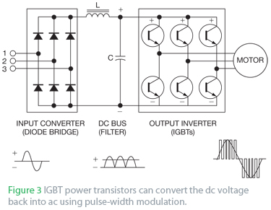
Basic Drive Topology
3 Phase AC from Distribution
IGBTs that fire in a sequence that feeds the motor
DC from the Input Converter is used to develop DC bus with the DC bus capacitors for the transistor output inverter
The output inverter uses DC to make a sine wave (AC) for the motor
3 Phase AC is converted to DC for the Drives DC bus
Notes:
Bonitron products work with any drive brand with DC +/- connections.

Slide 5
Drive DC Bus Management
Standard Product Power - 3 AC Line and 2 DC Bus Connections
Standard Unit Connectivity Make’s New Installations or Retrofits Easy and Non-Invasive to The Drive…
WE WON”T VOID A DRIVES WARRANTY!
Our Products Support all Line Voltages Worldwide
Enable Circuits, Ethernet Comms. or Control Power Options May Add a Few More Connections for Some Products
Notes:
Bonitron products work with any drive brand with DC +/- connections.

Slide 6
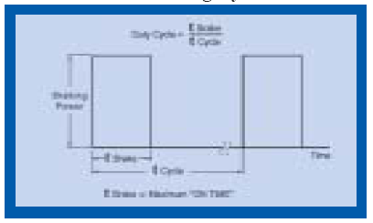
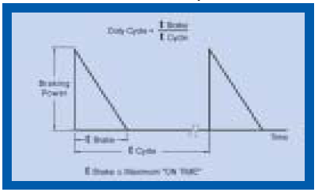
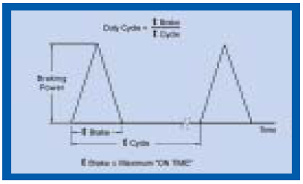
Regenerative Energy In Drives
Drive DC Bus “Regen” Profiles
Drive DC Bus Regenerative / Braking Conditions Can Be Sorted Into Three Basic Types:
Overhauling: 50-100%
During An Overhauling Load Cycle The Braking Resistor Keeps The Motor From Increasing Speed Beyond The Synchronous Speed Set By The Drive. The Required Braking Torque Remains Constant,
Therefore, Approximately Twice The Power Of A Deceleration Braking Cycle Is Required Of The Braking Resistor.
Deceleration: 10-30% (Dependent Upon Decel Time to Process Time)
During Deceleration The Braking Solution Is Used To Stop Or Reduce The Speed Of The Motor Through Reduction Of Over Current Of The DC Bus Of The Drive.
Eccentric:
The Required Braking Torque Reduces With Speed
Approximately One-half The Power Of An Overhauling Load Cycle Is Required Of The Braking Resistor. Most Drives Require Braking Resistors Only For Stopping And E-stop.
Examples: Anything That Stops Or Has Rapid Motion Changes, Servo Drive Systems, Pick And Place.
Examples: Rail Car Dumpers, Down Hill Conveyors, Hoists, Winches, Cranes.
Examples Of This Are Tumblers, Punch Presses And Pump Jacks, Centrifuges.
For Some Applications Regenerative Energy Solutions Are Required Because Of Torque Or Load Fluctuations While The Speed Remains Constant.

Slide 7
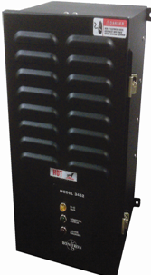
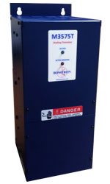
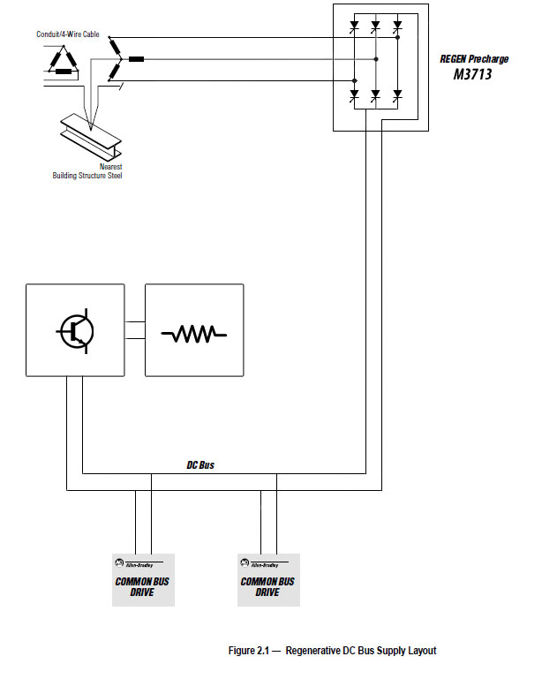

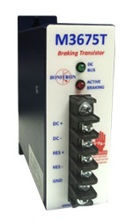
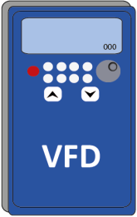
External Braking Transistors
“Choppers”
Drive DC Bus Connections
M3452
10-33% Braking Duty
Up to 43Hp
115-460VAC
Combination Brake Resistor & Transistor
M3575T
30 Amps – 600 Amps
10-20% Braking Duty
230-460VAC
M3452
Heavy Duty Braking Transistors
75 Amps – 1600 Amps Single Unit
Network Options
230-690VAC
M3675T
20% Braking Duty
Fractional-10 Hp
115-460VAC
7
Notes:
Bonitron has 3 series of braking transistors. Act as switch that allows overvoltage to flow into resistor to prevent drive faults.
Example – AB drive OV fault 810VDC, Bonitron Transistor turns on at 750VDC

Slide 8
Internal IGBT & External Braking Connections
VFD Internal Braking Transistors
Most Drives Have Internal Braking Transistors
Some Are Not Rated For Heavy or Higher Braking Duties
When Using The Internal Braking Transistor Use Different Connections Than DC+ and DC-
Line Regen Connects Only To DC + And DC- Bus Connections and Drive AC Line Input
The Resistor Selected For Use With Internal Braking Transistor Must Have A Greater or Equal Ohm Value Than The Minimum Ohm Value Of The VFD Internal Braking Transistor.
Different Drive Manufacturers Can Have Different Braking Resistor Connection Labels!
External Transistor or Line Regeneration Unit Is Required
With Drives Internal Braking Transistor, Use External Resistor Only, Connect To Br+ And Br-, Res+ or Res- etc.
7th IGBT, BR+ or BR- or RES+ or RES-
Notes:
PF 70
PF 700
PF 753
PF 755

Slide 9

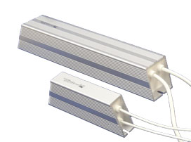
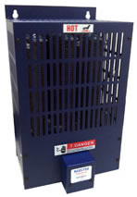
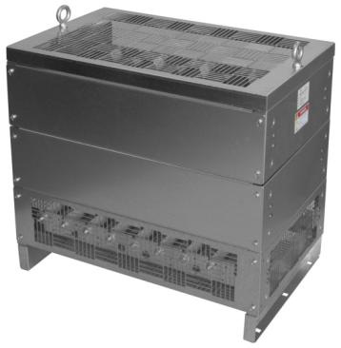
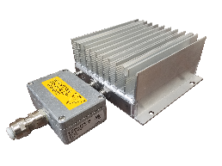
Braking Resistors
Convection or Fan Cooled
NEMA-3R
Stainless Steel – 366, 316
Various Build Options
Multiple Elements in One Enclosure for Multiple Braking Transistors
Custom 3 Phase Load Banks
100% Duty 100Hp+ Modular Braking Resistors
10-20%, 50% or 100% Braking Duty
Braking Resistors
Drive DC Bus Connections
Internal IGBT
External Brake Transistor
Case Resistors
56W – 11K Watts
M3775R
10, 20, 50 & 100% Duty
Fractional to 1000 Hp+
230-690VAC
NEMA 3R
Vertical Air Flow
Multiple Resistive Elements
M3575R
6-20% Duty
33 Hp Peak
230VAC – 460VAC
Case Resistors
1Hp–20Hp
IP 66 Wash Down
9
Notes:
There’s no need to go anywhere but Bonitron for your braking solutions. You can get your transistor AND resistor from us.

Slide 10
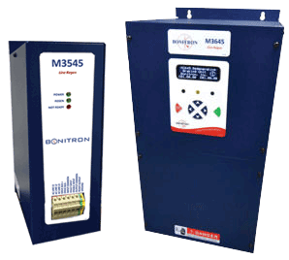
Line Regeneration Modules
M3545 and M3645 Line Regens
Features
Regenerative Energy From DC Over Voltage is Returned to the AC Line at 99% Efficiency
Digital HIM Display with Regenerative Energy Event Logging for Energy Savings
M3545 - 6A, 15A, 150% Peak Rated for 60 Seconds
150% Overload for 60 Seconds
208 - 600VAC Support
50/60Hz auto select
100A, Below M3645 and M3545 Units Below Have Internal Line Reactors and Transient Surge Suppression MOVs
M3645 - 30, 50, 100, 150A, 225A and 300A Amp units
Greater Than 100A Units Have External Required Choke Module
Notes:
10
The Bonitron Line Regen takes the place of a braking transistor and resistor. Instead of dumping excess energy into a resistor, the Bonitron Line Regen returns that energy back to the AC line. This reduces room cooling requirements and has a smaller footprint.

Slide 11
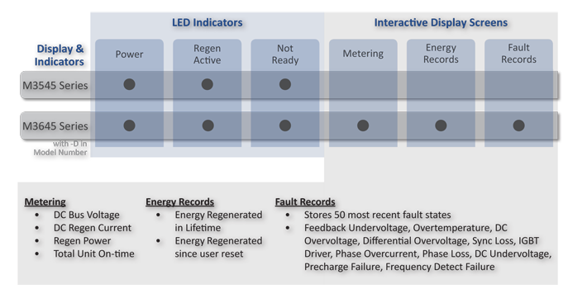
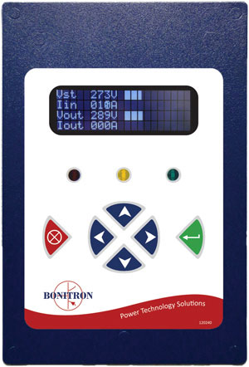
Line Regen Digital Display
Regen Digital Display Information

Slide 12
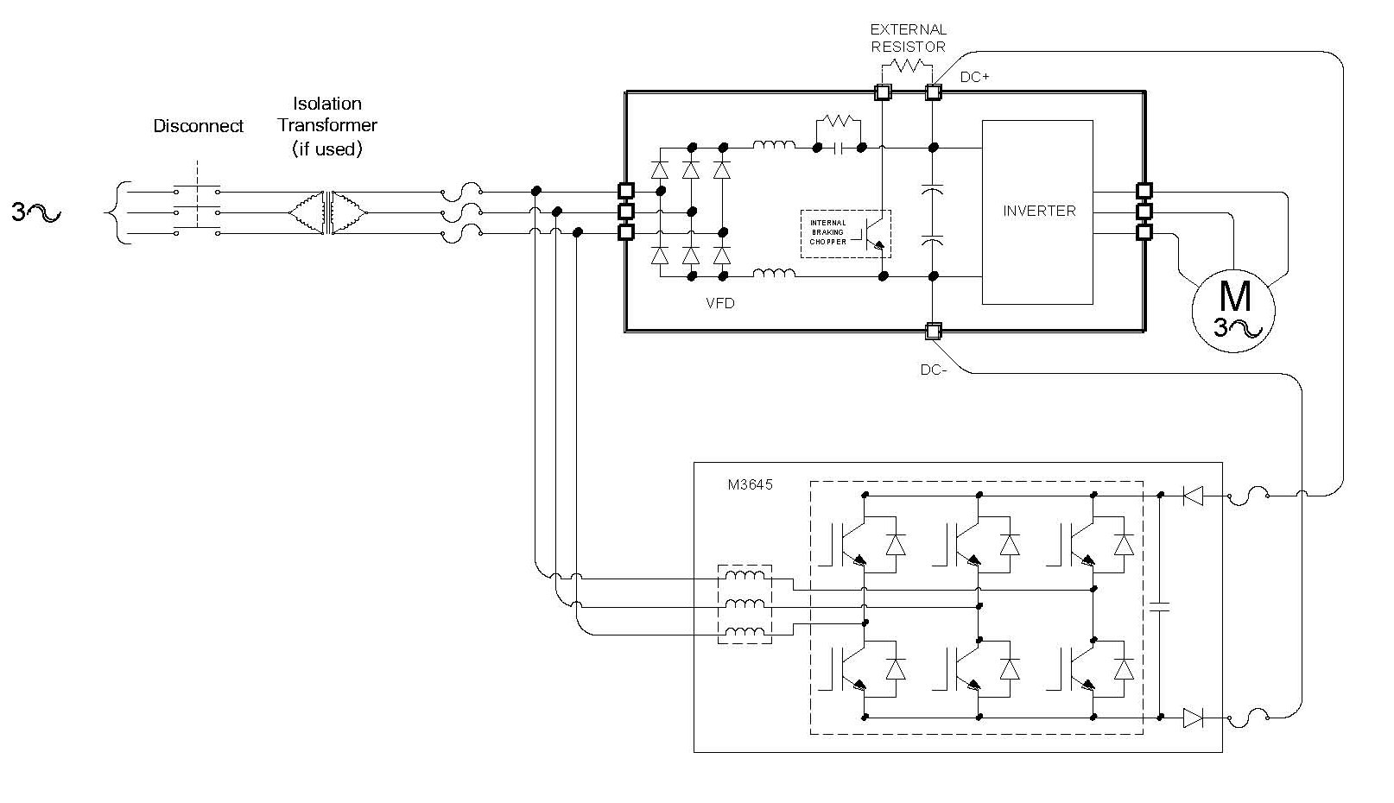
Line Regen Connectivity
Line Regen Functional Block Diagram
Notes:
Bonitron M3645 Line Regen returns the regenerated energy back to the input AC line.
The M3645 Line Regen synchronizes to the frequency of the incoming power line, allowing it to automatically adapt to 50Hz or 60Hz input. As the DC bus rises above the AC line peak, the M3645 redirects current from the DC bus into the AC line to limit the rise in bus voltage and prevent overvoltage faults. The M3645 is current limiting and will automatically fold back or shut down in the event that unsafe conditions are detected.
With the optional digital display, the current status of the M3645 is shown and fault records are stored along with a lifetime count of regenerative energy.
Up to two M3645 Line Regen units can be run in parallel for high-power applications

Slide 13


Determining Your OV Solution
What Bonitron Needs To Know for a DC Bus Over Voltage Solution
AC Line Voltage
Drive Hp or Hps or kW
Braking Duty Cycle or Overhauling Period Time In Relation to One Process Cycle in Percentage?
Common Bus Drives or Stand Alone?
Peak Braking Power (Braking Torque)?
Internal Braking Transistors Minimum Ohm Value?
Common Bus Drives All Fed AC Separately?
Questions for Customers
Deceleration
Overhauling
Combination

Slide 14
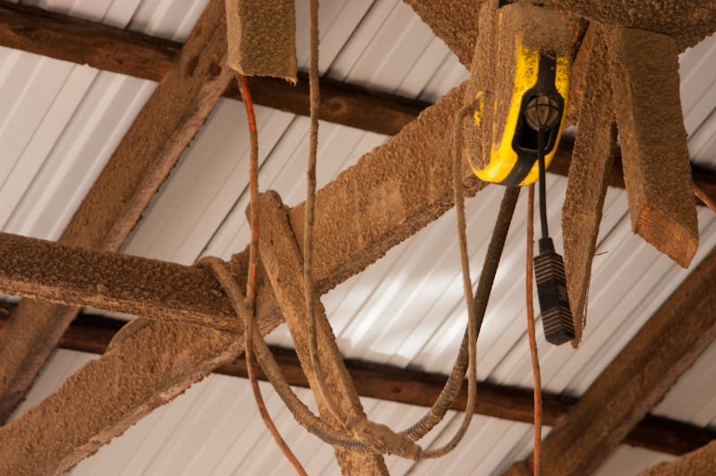
Line Regen Compared to Braking Resistor
Line Regen Verses Resistor
Line Regen
Return On Investment at Higher Duty Cycles
Resistive Braking
Some Drives Include Braking Transistors That Do Not Cover Braking Duty Required
High Braking Duty (50-100%)
Resistors Are Expensive And Large
Integrate Into Drive Cabinet
Regen Energy 99% Efficient
Resistors Too Hot For Flammable Areas
Flamable Material On a Resistor
= Fire Hazzard

Slide 15
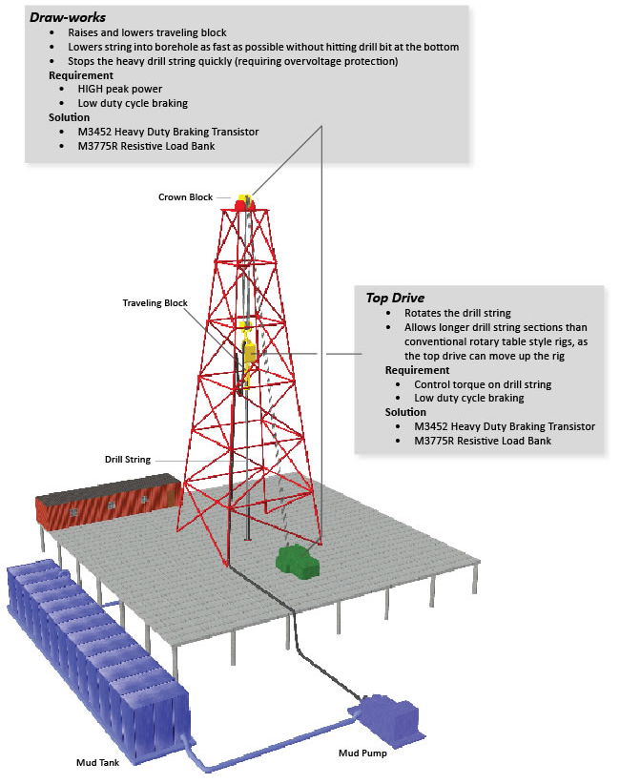
Line Regen Compared to Braking Resistor
Line Regen Verses Resistive Braking
Resistive Braking
Heavy Overhauling Loads Require An External Brake Transistor
High Braking Duty With High Peak Regen, Can Not Be Covered By Line Regen
Line Regen
Energy Savings Not An Issue
Environment Not An Issue For Braking Resistor
Extremely High Hps Required Not Covered By Regen Current Ratings
To Use Regen With Generator, Generator Must Be Sized to Handle Return AC Line Regen
Efficiency Less of an Issue Than Solutions Ability to Handle Large Amounts of Required Braking
When Using A Line Regen With a Generator

Slide 16
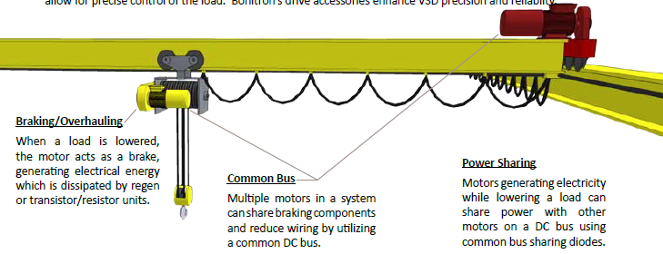
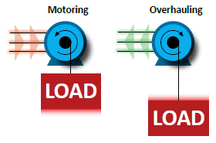
Cranes and Hoists (Overhauling)
Common Bus Regenerative Applications
Overvoltage
Regen Profile
Regenerative Energy created from Lowering Against Gravity and Deceleration at End of Lowering Portion of Cycle
Inertia from start/stop actions generally or from gravity on downhill conveyors which causes DC voltage to rise.
Line Regen and a resistive brake required to prevent drive overvoltage fault

Slide 17
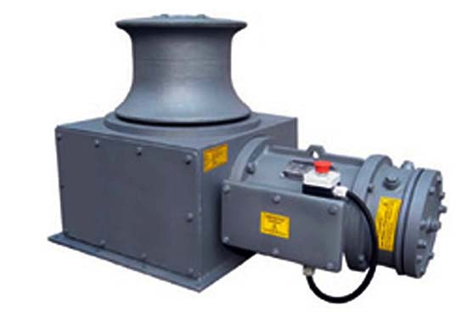
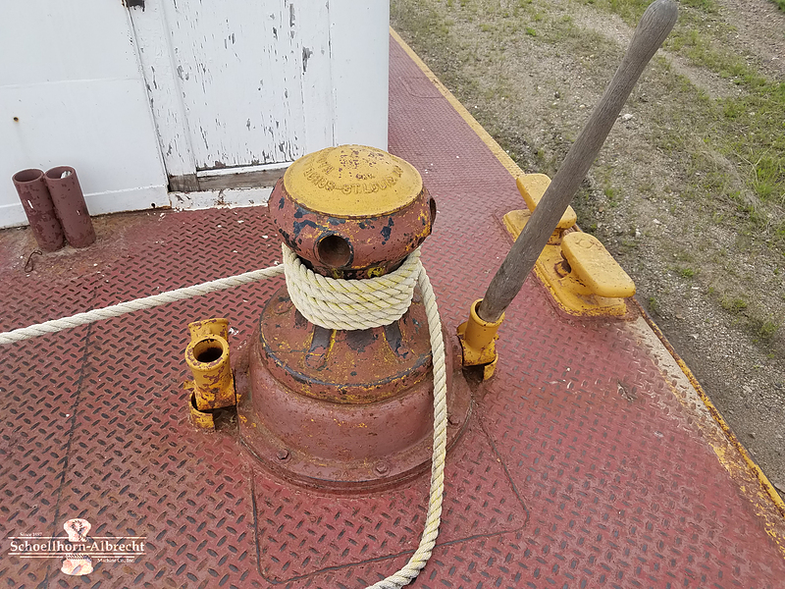
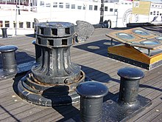
Barge Capstans, Anchor Windless
Regenerative Energy In Marine Applications
Regenerative Energy
Single Drive/Motor
Usually, Regen Energy is Created When Anchor is Dropped And A Hard Stop At The End of Anchor Travel.
Test Stands May Require Common DC Bus Due to Multiple Functions and Drives
Braking Duty Cycle Varies in Relation to Distance Anchor Dropped and Distance Raised.
Lines That Tie Ship to Pier Are Also Under Tension and Varied With Tide.

Slide 18
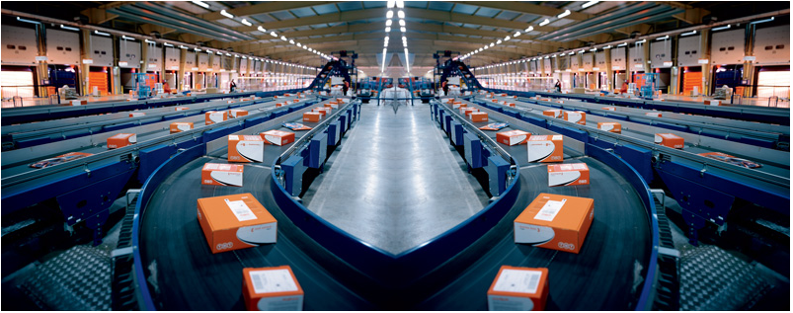
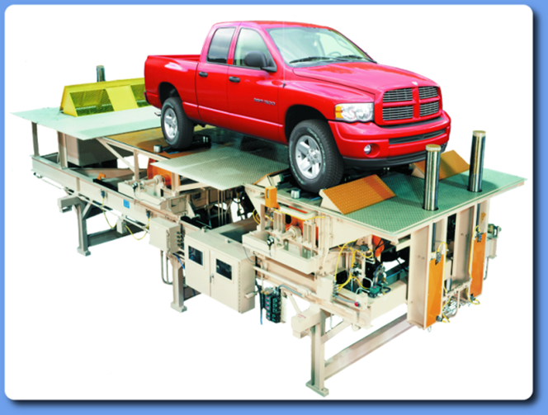
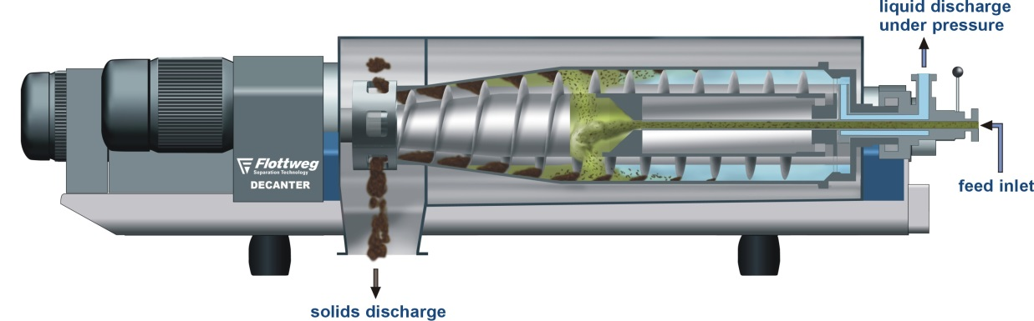
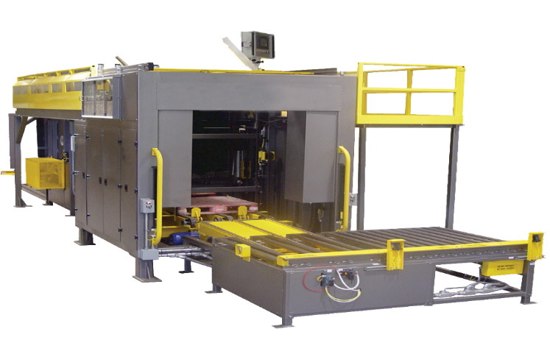
Common Bus Regenerative Applications
Continuous & Batch Process Centrifuges
100% Regeneration
Palletizers
50% Regenerative. Additional Downhill Conveyor on Common Bus – 100% Regenerative
Test Stands
50-100% Overhauling Variable Regen
Deceleration Regenerative Energy is Created by the Conveyor Stops and Hoist Motion
Dynamometers Act as a Motor That Drives the Equipment Under Test.
Continuous Process Centrifuges - The Drum Spins Faster Than The Augur Creating Continuous Overhauling Regen.
Palletizer Hoist Load And Relationship Of The Raising Length To The Lowering Length Determines The Regenerative Energy Duty Cycle
Must Be Able to Drive the Equipment at Any Speed and Develop any Level of Torque That The Test Requires.
Common Bus VFDs May Not Require Line Regen. Drives Can Share Regen Energy
Batch Process Centrifuges – Deceleration Time Determines Braking Duty
18

Slide 19
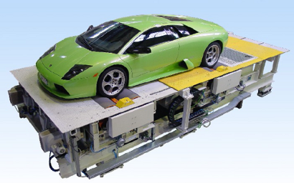
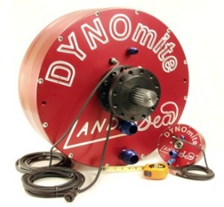
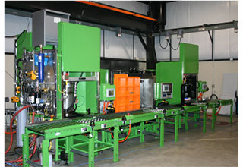
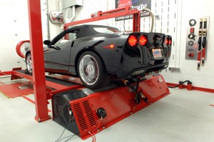
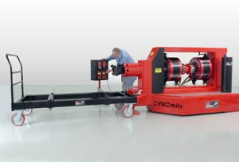
Test Stands
Common Bus Regenerative Applications In Motion Applications
Regenerative Energy
Common Bus
Variable Torque
Varying Levels of Regen
Multiple Drive Common Bus
All Drives May Not Present Regen Energy at The Same Time

Slide 20
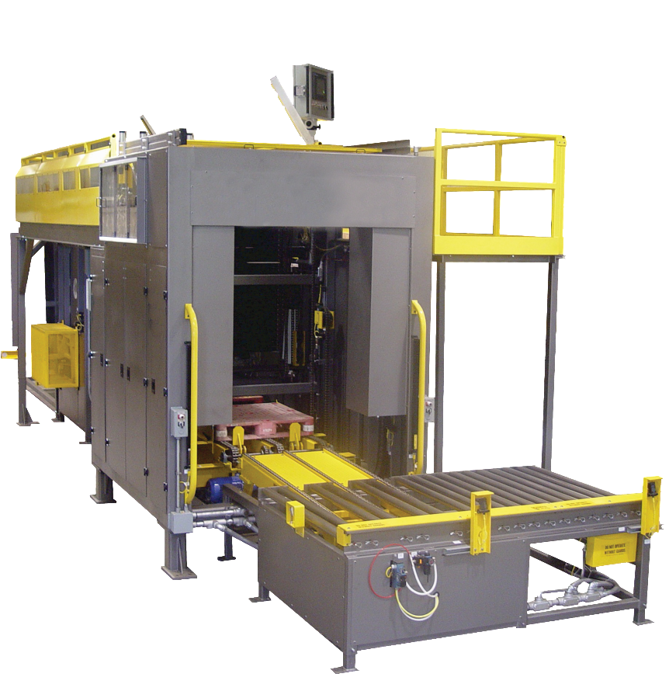
Palletizer Application
Common Bus Regenerative Applications
Regenerative Energy
Common Bus
Lowering Pallets
Start/Stop Of Conveyor
Braking Energy Created From Lowering Pallet Can Be Used To Power Other Drives, Such As Conveyor On Common DC Bus
End Compression

Slide 21
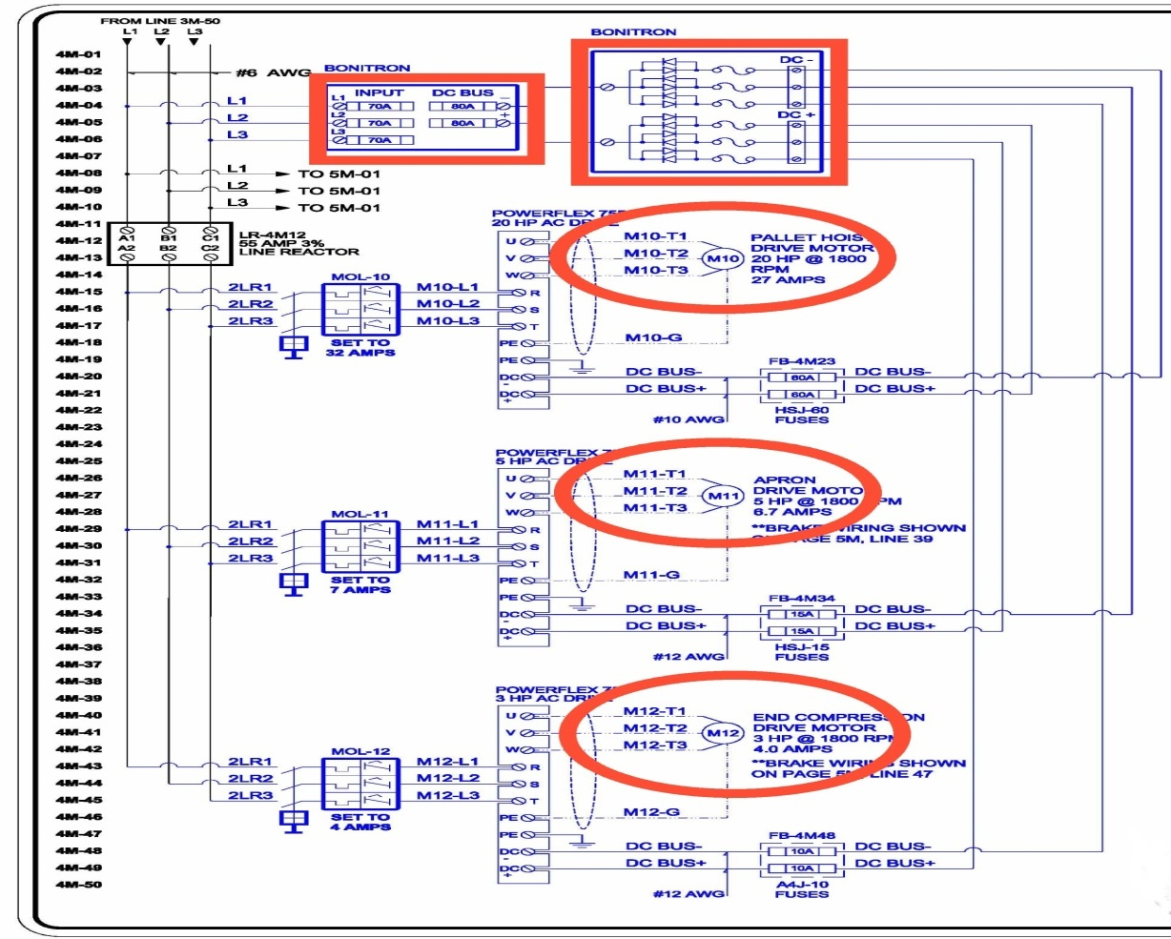
Palletizer Block Diagram
Common Bus Regenerative Applications
20 Hp Hoist. Regen Is Felt When Lowering Full Pallet
5 Hp Conveyor. Rapid Decel Creates Regen When Conveyor Stops Prior To Compressing Packages And When Compressing On The Pallet
3 Hp End Compression. Slight Regen When Shoving Packages Together
Final Solution:
Common Bus Diode Module
M3345CBM–30H3
Line Regeneration Module
M3645-H030-M10-D

Slide 22
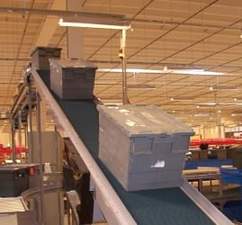
Downhill Conveyors (Overhauling)
Common Bus Regenerative Applications
Overvoltage
Common Bus
Regenerative Energy created from an overhauling (down hill) conveyor can be used to power/start other conveyors drives
Inertia from start/stop actions generally or from gravity on downhill conveyors which causes DC voltage to rise.
Line Regen and a resistive brake required to prevent drive overvoltage fault

Slide 23
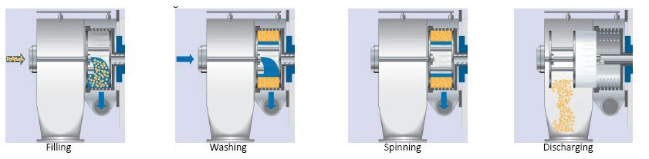
Continuous Centrifuge (Overhauling)
Common Bus Regenerative Applications
Overvoltage
Regen Profile
Regenerative Energy created from Auger.
100% Regenerative
The Drum Spins Faster Than The Augur
Continuous Regen Duty
Overhauling Profile
Drum
Auger
(Waste)
Notes:
Continuous Process Industrial centrifuges are used in filtering applications in most cases. The slurry is fed continuously to the product acceleration disc via the filling pipe. During the filling stage the waste water solution is moved through the drum while spinning the heavier waste particles to the perimeter.
During washing stage the and passes out of the centrifuge.
Heavier particles build up into a sludge or “cake” until it is pushed to be scraped out of the centrifuge. Automated removal of solids adds additional motors to the application but dramatically improves productivity.
The frequently used decanter centrifuge uses drives and motors on the infeed pump, main bowl, and screw conveyor which pulls solids out of the centrifuge. Centrifuges have very high inertia yet require high operational RPM’s. The combination is a challenging application for electric motors which want to pull 800% or more current until they reach full speed. Traditional across-the-line starting will generally not work for this application.
Look for decanter centrifuges where drives on main bowl and screw conveyor can share energy over a common DC bus for maximum energy savings.

Slide 24

Centrifuge Block Diagram
Common Bus Regenerative Applications
Common Bus
Augur Drive is 100% Regenerative
Augur Regenerates
Generally 50-100Hp VFDs are Used
Overhauling with Drum
Common Bus Drum and Auger Drives

Slide 25

Batch Process Centrifuge (Deceleration)
Common Bus Regenerative Applications
Overvoltage
Regen Profile
Peak Regen Energy At The Beginning Of Deceleration, Tapering Off to Zero.
Long Deceleration Regenerative Energy
Deceleration Time Determines Braking Duty Cycle Duty
Deceleration Regen Profile
Long Decelerations Can Appear As Continuous Regen Energy >60s
Notes:
Continuous Process Industrial centrifuges are used in filtering applications in most cases. The slurry is fed continuously to the product acceleration disc via the filling pipe. During the filling stage the waste water solution is moved through the drum while spinning the heavier waste particles to the perimeter.
During washing stage the and passes out of the centrifuge.
Heavier particles build up into a sludge or “cake” until it is pushed to be scraped out of the centrifuge. Automated removal of solids adds additional motors to the application but dramatically improves productivity.
The frequently used decanter centrifuge uses drives and motors on the infeed pump, main bowl, and screw conveyor which pulls solids out of the centrifuge. Centrifuges have very high inertia yet require high operational RPM’s. The combination is a challenging application for electric motors which want to pull 800% or more current until they reach full speed. Traditional across-the-line starting will generally not work for this application.
Look for decanter centrifuges where drives on main bowl and screw conveyor can share energy over a common DC bus for maximum energy savings.

Slide 26


Common Bus Power Supplies
M3713 Common Bus Power Supply
M3713SC & M3713DM Versions
Drives Powered Via DC +/-
Drives Share Power
Single Or 3-phase AC Input
Regenerative Energy Solution Can Be Sized To Cover Multiple Inverters
Can Be Configured For 12 And 18 Pulse Solution With Drive Converter
With And Without Drive Pre-charge. SC With, DM Without
AC In. DC Out
Notes:
Common Bus Power Supply
Using a common bus power supply reduces the amount of wiring and components in a system, resulting in a reduction of maintenance and footprint of the system. In a system with multiple motors, some motors may be regenerating while others are motoring. The common bus allows the regenerating drives to share power with the motoring drives, thus reducing the amount of power needed from the grid. If the drives are creating a net surplus of energy, a single line regen or braking unit can be installed to dissipate the excess energy.

Slide 27


12 & 18 Pulse Harmonic Solution
IEEE 519 Harmonic Mitigation
M3713
Drive Front End or M3713SC
Common Bus Drives Add Harmonics
M3713

Slide 28



Common Bus Power Supplies & Regen
M3713SC & DM
Common Bus PS Features
DC Bus Can Share Circulating Energy
Only VFD DC Fed Inverters Required
M3713SC Or M3713DM With M3645 Line Regen
Sized to Total regen Current On DC Bus With Multiple Drive Common Bus
SC Version - Single Pre-charge for Multiple Drives
Regenerative Energy is returned to The Line at 99% Efficiency from Entire Common Bus
3 Phase AC Drive Input
Multiple Drive DC Bus

Slide 29
Regenerative Power Supply
Power Supply + Line Regen in A Single Unit
M3545P & M3645P Line Regen
M3645P – 30A, 50A, 100A, 300A
Only Drives Inverter Section is Required
Separate Pre-charge Module Option
No Diode Sharing is Required
Internal Line Reactor 5% 30 to 100A Units
300A Separate Line Reactor, Choke
AC & DC Fusing Kits (less $$)
M3545P – 15A 100%
150% 60 Seconds
22A Peak for 60 Seconds
MOV Module
Turns Standard Drive Regenerative
M3545P & M3645P Regen Power Supply
3 Phase AC Drive Input
Multiple Drive DC Bus

Slide 30


Common Bus Diode Sharing
Multiple Drives Individual AC Feeds
Sharing Diodes
Common Drive DC Bus
M3345CBM
Separate AC Feeds For Each Drive Rectifier
Diode Drops on DC+ and DC
Diodes Help Control Circulating Currents From Larger Drives For Protecting Smaller Drives on DC Bus During Pre-charge
Single Over Voltage or Under Voltage Solution Can Cover Total Of Drives On The Common Bus
Line Regen Unit, Brake Transistor & Resistor or UPD
3 Phase AC Line Separate Drive Feeds
M3345CBM Bi-Directional Diode Modules
Notes:
Common Bus Sharing Diodes
M3345CBM
If drives on the AC line are connected by a DC bus, circulating currents can be created that might cause drive faults. The sharing diodes allow a two way flow of power to and from drives enabling them to share power between their DC busses while preventing circulating currents. The two-way flow allows the drives to share power with each other and use a common braking, regen, or UPD.
Common Bus Isolation Diodes
M3345D, M3460D
Unlike the sharing diodes, the isolation diodes allow only a one-way flow of power and do not allow drives to share power with each other, completely isolating the drives and preventing circulating currents. The isolation diodes allow multiple drives to be connected on the DC bus so that they can share one braking unit, regen, or UPD. The M3345D allows an outward flow of power from the connected drives to be dissipated by a braking or regen unit. The M3460D allows inward flow of power so that one UPD can power all of the drives connected to the DC bus.

Slide 31


M3712 Single Phase Power Supply
M3712 Single Phase Power Supply
3-phase Drives/Motors Must Be De-rated 50-70% for Use With Single Phase Power
Output Drive DC Bus Power
Can Parallel
Input 230VAC and 460VAC
Multiple DC Bus Connected Drive One M3712
With the M3712 Single Phase Power Supply, NO Drive or Motor De-rate Needed
30, 50, 75, 125Hp
Drive De-rating NOT Required
Notes:
Technically, Bonitron offers another Common Bus Power Supply, however this 3712 Series is specifically for those with only single phase AC power.
The M3712 Single Phase Power Supply takes a single phase AC input and outputs DC voltage that will power the DC +/- terminals of an AC drive.
Normally, users must buy a 3-phase drive 2-3 times larger than necessary if they are going to power it with only single phase power. Many drive manufacturers do not recommend this as it can decrease the drive’s life and jeopardize UL status.
For example:
A 50HP application would require a much more expensive 100-150HP 3-phase drive.
But with Bonitron a 50HP applicaton would require a line reactor, 50HP M3712 unit, 50HP drive.

Slide 32







Critical Process Drives Under Voltage Protection
AC Line Loss (Utility Power)
Utility Power Can Be Lost In An Instant…
Fallen Trees
Flooding
Lightning Strikes
Mother Nature
Human Nature
Slide
34
Brown Out
32

Slide 33


Critical Process Protection
Critical Process Ride Thru
Down Time Losses Outweigh Solution Cost
Critical Process Multiple Levels of Redundancy Required
Process Can Not Tolerate Motor Performance Deviations
Strict Environmental Systems Requirements (HVAC Protection)
Ride Thru Solutions are More Expensive Than the Drive Being Backed Up
Established Solution Specification Requirements
Losses Due To Drive Under Voltage Events
Lost Product Revenue
Non-Productive Personnel
Damaged Process Machinery
Reworking Equipment
Restarting Equipment
Costly Cleanups
Drive Repair
Hazardous Personnel Conditions
Why Maintain VFD Power During AC Line Sag and Outage Events
The Need for Process Level Protection
$$$ in Losses

Slide 34





Process Protection
AC Line Loss (Internal Plant)
Partial 3 Phase AC Line Loss Sags
Usually Cycles, Less Than 1 Second
One or All Three Phases Affected
Remaining AC Can Be Used For Ride Thru
Internal Plant Physical Environment
System & Drive Fault Settings
Internal Plant Load Shifting
Internal Plant PQ
Reclosures
100% Short Term AC Line Loss
Usually Cycles to Seconds
0.5 to 5 Seconds
All Three Phases Affected. 0 Volts
Energy Storage Required
Operator Error
Last Maintenance Actions Accomplished
100% Long Term AC Line Loss
Usually Seconds to Minutes
kW Dependent, 5 Seconds Plus
All Three Phases Affected. 0 Volts
Energy Storage Required

Slide 35





Critical Process Protection
What is a Critical Process?
Critical Process Backup Reasons
Personnel Safety Can Be Compromised if the Associated Process Motor Losses Power and Becomes Erratic
Data Centers – Environmental Systems Backup
Critical Process Examples
Semiconductor – Cleanroom Air Handlers & Machine Tool Chill Water
Lubrication Systems
Safety Systems
Security Gates
Loss of Security System Power Can Allow Intrusion Into High Security Areas
Loss of Power to Equipment’s Personnel Safety Features Can Create Hazzard to Workers
Hoists & Cranes Can Drop Load
Power to Security Access Areas is Cut During Breach Attempts
Robotics Multi Axis Systems Lose Reference Causing Damage to Mechanical Components or Surrounding Equipment
High Speed Turbines Can Burn up Without Constant Lubrication
Cleans Rooms Must Remain Free of Environmental Particulates or Expensive Semiconductor Wafers are Discarded
Machine Tools for Wafer Etching Must maintain Constant Chill Water Cooling Due to High Speed Operation
Any Slight Deviation in Motor Speed or Torque Can Create Scrap Product and Expensive Production Loses or Cleanup
Critical Data Can Be Lost if Environmental Systems Are Lost and Data Servers Overheat
Chemical and Toxic Exhaust Ventilation
Loss of Ventilation and Exhaust Fans can Create Personnel Hazzard from Toxic Gases
Perishable Products can Be Lost During AC Line Loss that Can Trip Refrigeration Compressor VFDs/Motors

Slide 36






Current Industry Solutions
Ride Thru Solution Selection
UPS
AC Line Sag Corrector
Motor Inertia
DC Bus Ride Thru
VFD Active Front End

Slide 37
Critical Process Protection
Plant Redundancy
Power Distribution UPS
Plant Gen Set
Plant Backup Systems & Redundancy
Process Level VFD Backup
Solution selection is usually dependent on the critical nature of an application. In critical applications, several levels of plant process and drive/motor protection are required. “Redundancy Levels”.
This is common in applications such as Semiconductor and Data Center HVAC VFD Systems where no change in speed or torque of the associated motor can occur.

Slide 38
Determining Your UV Solution
Questions for Customers
What Bonitron Needs To Know for a Drive Under Voltage Solution
AC Line Voltage
Drive Hp or Multiple Drive Total Hps or kW
Sag or 100% AC Line Loss
Common Bus Drives or Stand Alone
Sag – Percent & Time AC Line Lost
Internal Braking Transistors Minimum Ohm Value
100% 3 Phase Outage Time – Greater Than 50%, Energy Storage
50% Sag, 50% Remaining - Single Voltage Regulator Booster
Sag – 50% AC Line
2s or Less
Outage – 100% AC Line
10s or Less (kW Dependent)
Outage – 100% AC Line
10s or Greater (kW Dependent)

Slide 39
























UPD AC Line Loss/VSD DC Bus Backup Products
UPD – Uninterruptable Power For Drives
UPD Integratable Sag Modules
UPD 100% AC Line Loss Integratable Modules
M3534R 2 Seconds 50% Sags
M3460R 2 Seconds 50% Sags
M3534B/M3460B (HD Booster) Ultracapacitor 3-10 Seconds
M3534B/M3460B + Batteries 10 Seconds to 30 Minutes +
UPD Multiple Drive Solution
M3460D UPD RT Common Bus Diodes
0.5 to 15 Seconds
15 Seconds to 60 Minutes
UPD Sag Cabinet Systems
S3534SR – 2 Second 50% Sags – 10-50kW
S3460SR – 2 Second 50% Sags – 50-250kW+
UPD 100% AC Line Loss Cabinet Systems
Control Power Backup
Sags & Outages
S3534UR, S3460UR – 3-10 Seconds – 10-250kW
S3534BR, S3460BR –10 Seconds to 30 Minutes – 10-250kW+
24VDC Control Power Ride Thru
0.5-2 Second 100% AC Line Loss Modules
M3534R + Ucaps – 0.5-2 Seconds AC Line Loss
M3460R + Ucaps – 0.5-2 Seconds AC Line Loss
39
Notes:
Bonitron has 3 series of braking transistors. Act as switch that allows overvoltage to flow into resistor to prevent drive faults.
Example – AB drive OV fault 810VDC, Bonitron Transistor turns on at 750VDC

Slide 40


UPD – Uninterruptable Power For Drives
UPD Product Number Selection
Part Number Breakdown
S or M3460R-H100-R9-F
Integratable Modules
V/R Booster Type
Max
kW
Open Chassis
Type
50% Sag Protection
AC Line
H-480VAC
E-380-415VAC
C-600VAC
Fusing
100% AC Line Outage Protection
Up to 250kW Single Unit.
3 Phase 2 Second Sags
50% AC Line Remaining
Full Cabinet Systems Are Designated With An “S”
Integratable Modules Are Designated With
An “M”
Up to 250kW Single Unit
0.5 Seconds to Minutes 100% AC Line Loss
Model Number Designators
M = Module
S = System
BR = Batteries
SR = Sag RT
UR = Ultracapacitor
CR = Low Hp Electrolytic Caps
EC = Low Hp Electrolytic Caps
40

Slide 41
UPD Display Options
Records Menu
View Ride Thru Event Statistics Or Individual Event Records
Actions Menu
Threshold Check
DC Bus Voltage Fault Logic
TEST Initiate
The System Ships With Records Of A Single Event Initiated During Checkout
RT Event Parameters
100 Most Recent Fault States
Configurations Menu
Set Time
Set Status Timer
  Legacy Analog Display Option
  DP10 Legacy
  DP 17 Obsolete
  LEDS
  RT Event Counter
  Green – Power
  Amber – Ride Thru / Charger Active
  Red – Fault

Slide 42







UPD – Uninterruptable Power For Drives
UPD Ultracapacitor System Components
Short Term Outage
Ultracapacitor Energy Storage
Electrolytic Capacitor Energy Storage
0.5 – 10 Seconds 100% 3-phase outages,
Less Than 15kW
10kW - 250kW
Less Than 0.5 Sec
150kW 1 Second Full AC Line Loss Ucap Energy Storage Included in Adjoining Bay
VR - Voltage Regulator
CH – Isolated Charger
CAP - Capacitors
DCH – Ucap Discharger
60Hp 1 Second Full AC Line Loss Ultracapacitor Energy Storage Included

Slide 43

UPD – Uninterruptable Power For Drives
Capacitor Energy Storage
Bonitron Short Term AC Line Full Outage Ride Thru Requires Capacitor Energy Storage To Maintain The DC Bus Level For Seamless Operation Through Ride Thru Events
Electrolytic Capacitors
Ultracapacitors
M5628 Isolated Charger
Isolation Transformer No Longer Required with M5628
700V Assembly
48V Modules
Up to ½ Second Full Outage
½ Second Outages
Used With M3534EC
Low Hp Drives
Less Than 15kW
Up to 15 Seconds Full Outage
Cost Effective for Short Outages
Can Be Used With
M3460R (Up To 3 Sec)
M3460B (3-10 Sec)
Low to High Hp Drives
10-1000+ kW
Selection – Cost & Space Available
kW x Outage Time = kJoules
Capacitance = 2(kJ) / V Squared
Notes:
43
Electrolytic and Ultracapacitors are 10+ years with no maintenance.
Batteries would be serviced the same as UPS applications, great support from local service providers.

Slide 44




UPD – Uninterruptable Power For Drives
UPD Battery System Components
Long Term Outage
15 Seconds - Minutes
100% 3-Phase Outages
Battery Energy Storage
VRLA Standard, Other Battery Types Available
Does Not Require Discharger
VR - Voltage Regulator Booster
CH - Charger
B - Battery Energy Storage
230VAC, 50kW
30 Seconds Battery Energy Storage Included
Battery Energy Storage
460VAC, 250kW
15 Minutes

Slide 45


Critical Process Protection
Data Centers
Backup Utility Power Circuits
Utility Substation
Cooling
Tower
Switching Relays
Chiller
Chill Water Tanks
AC Line Plant Input Distribution
Air Handler
Main Utility Station
Backup Utility Distribution
Chiller
Air Handling Fans
Cooling Tower
Chilled Water Loop
Chill Water Must Be Maintained to HVAC Systems 100%
Particulate Contamination Can Compromise And Damage Filtration Systems & Sensitive Digital Circuitry
Chill Water System Sensors Can Shut Down a Systems Even Though The Associated VSD Does Not Trip
Usually Outdoors – Nema 3R
Data Center Redundancy
N+ Levels
N+1
N+2
N+3
N+4
Drive Cabinet
Data Center Servers
Bonitron UPD VSD DC Bus Backup
Notes:
Utility
Substations
Exposed power lines
Transformers
Backup Switching
Control Room
UPS or Sag Corrector
Oversized plant-wide solution
Process still vulnerable to PQ issues within plant
Bonitron UPD
Direct drive connection at drive location

Slide 46

Critical Process Protection
Semiconductor
Backup Utility Power Circuits
Utility Substation
Switching Relays
Cooling
Tower
Chiller
Chill Water Tanks
AC Line Plant Input Distribution
Air Handler
Backup Generation or Cogeneration
Wafer Etching Clean Rooms
Constant Airflow Required For Maintaining Uncontaminated Wafer Etching
Process Chill Water Chillers Require Constant Stable Power To Avoid Lengthy Shutdown/Restart Time
Ride Thru Serves As Bridge Between Power Sag or Outage Until Generators Start or Utility Power Is Restored
Critical Processes Cannot Tolerate a Loss of Motor Speed or Torque in Environmental Systems.
Air Handler Filtration
Wafer Etching Machine Tools
Drive Cabinet
Bonitron UPD VSD DC Bus Backup
46
Notes:
Utility
Substations
Exposed power lines
Control Room
UPS or Sag Corrector
Oversized plant-wide solution
Process still vulnerable to PQ issues within plant

Slide 47





Critical Process Protection
Single UPD – Multiple Drives M3460D Diode Sharing
Chiller
Air Handling Fans
Cooling Tower
Chilled Water Loop
VFD Chill Water Pumps
Decrease in Chill Water Flow Can Trip Associated Equipment
Outdoor Nema 3R
Multiple Drives – One UPD
Constant Airflow
Contamination Levels
Machine Tool may not Trip But Could Overheat
Additional Process Equipment
Light Curtains
Safety Sensors
Drive Control Power
PLC Networks
Remote Monitoring Stations

Slide 48







Critical Application Examples
Clean Rooms
Clean Room Air Handling And Environmental Systems
Cooling Water Systems For Machine Tools (Wafer Etching)
Must Maintain Constant Air And Water Flow Rates To Maintain Product Quality
Industry Requirement: Semi-F47
Solution
UPD Modules
90 Seconds
2 Second 50% Sags
Semiconductor – 90 Second Outage & 50% Sags
Singapore
Taiwan, USA
2-Second 50% 3-Phase Sag
90-Second Full Outage
Notes:
48
Shows the contrast of regional specifications

Slide 49




Critical Application Examples
Semiconductor - 1 Second Power Vaccine
Application
Clean room air handling and environmental systems
Cooling water systems for machine tools (wafer etching)
Must maintain constant air and water flow rates to maintain product quality
Process Cooling Water
Solution
1 Second Power Vaccine
Austin, TX
1-Second Outage
Notes:
Power Vaccine Spec. Provides a greater level of protection than Semi F47

Slide 50

Critical Process Applications with PF Drives - Fibers
Fiber Process Extruders
Fiber Process Tension Systems
Polymer Or Fiber Material Pumps
Process Speed Changes Due To AC Line Sag Or Outage Event Cause Inconsistent Tension In Finished Fiber Product In The Fiber Winding Portion Of The Process Creating Breaks and Scrap, Resulting In High Dollar Product Losses.
Pump Speed Must Be Maintained To Provide A Consistent Fiber Material Flow To The Extruder
Change In Speed Or Torque Of The Motor Creates Unusable Fiber Extrusion
A Drive May Not Trip With An Under Voltage Fault Due To VFDs Having A Small Amount Of Ride Thru (Cycles Only) The Motor May Lose Speed And Torque Resulting In a “Grade B” Extrusion Scrape Product.
Utility Or Internal Plant PQ Profile Will Determine The Type UPD Product To Be Specified And If Energy Storage Is Required
50

Slide 51





Critical Application Examples
FIBERS – 0.5 and 2 Second Outage
Extrusion
Fabric Roller And Tension Systems
Must Maintain Constant Speed/Tension On Rollers And Un-rollers
Positional Fiber Lines
Injection Pumps
Solution
UPD Modules
2 Second Sags / 0.5 – 2 Seconds
USA
Indonesia
½ Second Outage
2-Second 50% Sag
Notes:
51
Started providing RT in the fibers industry with Dupont in the mid 70s
Indorama India is also 50% 2 Second 2 Second

Slide 52






Critical Application Examples
Progressive Cavity Pumps/Electric Submersible Pumps
Application
Heavy crude extraction
Return on Investment of 2 months at $50/barrel
Drive trip creates excessive downtime
Venezuela
Colombia
1 Second Outage
S3534UR
60Hp, 1 Second Ultracapacitor Energy Storage

Slide 53
Critical Application Examples
Single UPD – Multiple Drives M3460D Diode Sharing
India – Gail Gas Utility
Turbine Lubrication
Lubrication System Backup Power
Loss Of Lubrication System Creates Catastrophic Damage To Gas Turbine
Solution
UPD Cabinet System
18 Seconds 100% AC Line Loss
Full Outage
Notes:
Lubrication systems must be brought up first and the turbine started

Slide 54
Bonitron Maintenance Advantage
Bonitron UPD Systems & Modules Require Minimal Maintenance
Bonitron UPD Equipment Requires Very Minimal Maintenance
Maintenance Includes A Short Test And Monitoring LEDs And The DD5 Display When Required
Bonitron Equipment Is A Parallel Solution
Bonitron UPD Equipment Does Not Pass All The AC To The VFD As Does a Series Solution Tied To The Input Of The VFD Which Greatly Extends UPD Product Life
It Is Activated For A Few Minutes And Remains In A Static State Waiting For The Next RT Event Using Much Less Energy Than a Series AC Input Solution (One Tenth)

Slide 55

Drive Maintenance Products
Portable Units for Capacitor Testing and Forming
Ultracapacitor Testers
M3628PCF Manual Capacitor Formers
Form Capacitors Manually
Benchtop Power Supply 0-900VDC
Tests Ultracapacitors
M3628ACF Automatic Capacitor Former
Measure Capacitance and ESR to Determine When End of Life is Reached
110 & 220VAC Versions
Maximum Capacitance 100,000 uF
Output Voltage 1000VDC, Max Load 300,000 uF
Programmable
Do Not Require Forming
Regenerative Energy Monitor
Drive DC Bus Regen Monitoring
Requires Previously Installed Brake Solution
ACF Operational Video
https://www.youtube.com/watch?v=543rPcwyqis&t=11s
PCF Operational Video
https://www.youtube.com/watch?v=lzH7dbczeZ4&t=5s

Slide 56


Bonitron Applications Summary
If There Is a Drive, There Is An Opportunity
Agriculture & Irrigation
Automotive
Chemical/Food Processing
Elevators & Escalators
Single Phase Power
3 Phase VFD Efficiency
Alternative Energy
No De-rate
Rapid Motion Changes
Hoists
Paint Environments
Multiple Axis Servo Motors and Drives
Common DC Bus
Critical Process VFD DC Bus Backup
Centrifuges
Mixers
Process Protection
Utility Power Event VFD Personnel Safety Ride Thru
Regenerative Energy Management
Rapid Stops Cause Injury
Mining
Packaging
Pulp & Paper
Oil & Gas
Rapid Motion Changes
Hard Deceleration
Down Hill Movement
Common DC Bus
Rail Cars
Down Hill Conveyors
Smelting
Rapid Motion Changes
Hard Decelerations
Palletizers
Down Hill Conveyors
Wrapping
Much Dust & Particulates in The Air
Resistor Fire Hazard
Large Motors for Rolling Paper
Wind and Unwind Functions Large Rolls
Common Bus
Downhill Conveyors
Drilling
Pumping
Refining
High Duty & Hp Regen
Drill Rigs, Pump Jacks
PCP & ESP Pumping
Petroleum Processing
Lubrication Pumps
Security Gates
Semiconductor & Data Centers
Timber & Logging
Water & Wastewater
Gates Can Be Breached in The event of a Terrorist Attack
VFDs Operating the Gates Use Backup Power During an Outage in The Event of Purposeful Interruption
Critical Process VFD DC Bus Backup Constant Torque & Speed
Down Time Costs 100K in Minutes
Chill Water Machine Tools
Air Handlers Clean Rooms
Chip Washing & Packaging
Resistor Fire Hazard
Large Motors for Hoists
Cutting Debarking and Moving Logs
Downhill Conveyors
Log Flumes
IEEE 519 Spec
12 & 18 Pulse
Centrifuges
Filtration Systems

Slide 57

Bonitron Support
Product Pages
Sales Brochures
User Manuals
Industry Applications
Drive Cross References
Contact Form

Slide 58

www.Bonitron.com

